Slide 1
Indian Election Winner’s Prediction using ML Algorithms
Team members:
Dhanush Kotni, Karan Vyas, Awanish Pandey, Utkarsh Pimple, Udiksha Solanki

Slide 2
Problem Definition
The problem at hand involves developing a data-driven solution to predict the winners of Indian elections. The primary objective is to build a reliable machine learning model that can forecast the outcomes of parliamentary or state assembly elections based on historical data and relevant features. Accurately predicting election winners would provide valuable insights to political parties, candidates, and other stakeholders, enabling them to make informed strategic decisions during their campaigns.

Slide 3
Current solution to the problem
Using existing Machine Learning Models: Many data scientists and researchers have developed machine learning models to predict election winners in India. These models often use historical election data, demographic information, candidate profiles, and campaign data as input features. The models may include algorithms like logistic regression, random forests, gradient boosting, or deep learning techniques to achieve accurate predictions.
Data Enrichment and Social Media Analysis: To improve prediction accuracy, some solutions might have incorporated additional data sources, such as socio-economic indicators and sentiment analysis from social media platforms. Social media sentiment analysis can provide insights into public opinion and political trends, which can be valuable for understanding voter behavior.

Slide 4
Business Problem
Our group aims to develop a data-driven solution to predict the winners of Indian elections. The objective is to build a reliable machine learning model that can forecast the outcomes of parliamentary or state assembly elections based on historical data and relevant features. By accurately predicting election winners, we aim to provide valuable insights to political parties, candidates, and other stakeholders, enabling them to make informed strategic decisions during their campaigns.

Slide 5
Approach
To achieve the objectives of this project, we will require comprehensive and reliable data from various sources, including:
Historical Election Results: Past election results at the constituency level, including the winning candidate and vote share for each major political party.
Demographic Data: Voter demographics, including age, gender, income level, education, and occupation, for each constituency.
Candidate Profiles: Information about candidates, such as their political affiliation, previous political experience, educational background, and criminal records (if any).
Campaign Data: Data on campaign spending, rallies, public engagements, and social media activities for each candidate.
Socio-Economic Indicators: Socio-economic indicators like GDP per capita, unemployment rate, literacy rate, etc., that might influence voting patterns.

Slide 6
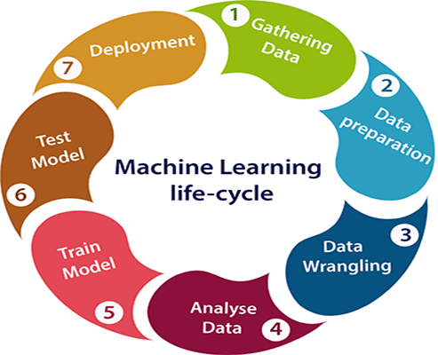
Machine Learning Life cycle
Gathering Data
This election database contains detailed candidate‐level data for elections to the lower houses of India’s national and state legislatures, i.e., the Lok Sabha and Vidhan Sabhas. The data span 1977‐2015, with each row representing a candidate that ran for office in that state‐year.

Slide 7
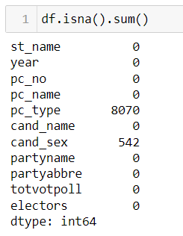
2. Data preparation
Data Collection and Preprocessing:
Gather historical election data from reliable sources, including past election results, voter demographics, candidate profiles, and campaign data at the constituency level.
Clean and preprocess the data to handle missing values, outliers, and inconsistencies, ensuring data quality and consistency.

Slide 8
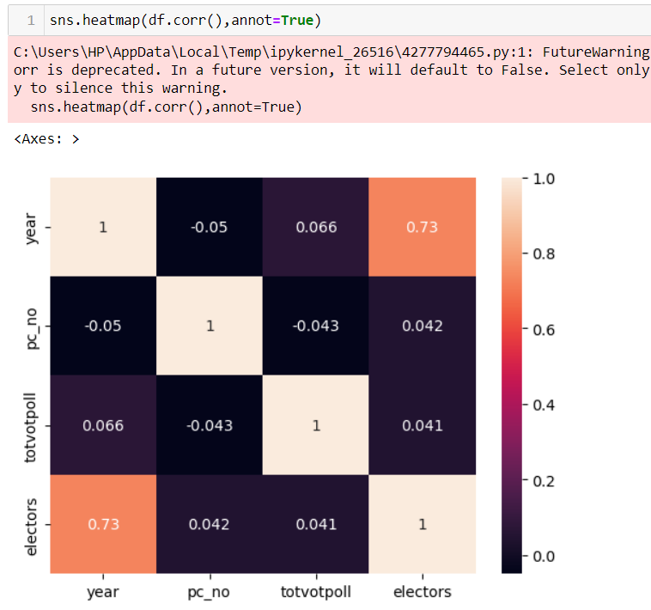
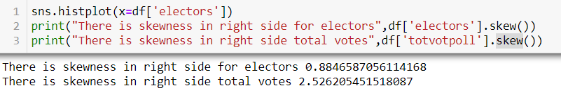
EDA
Relationship between variables:
These variables can be input data features which have been used to forecast our target variable. Correlation, statistical technique which determines how one variables moves/changes in relation with the other variables.
Statistical significance of variable or Skewness
Skewness is a measure of asymmetry of a distribution. Another measure that describes the shape of a distribution is kurtosis. When a distribution is asymmetrical the tail of the distribution is skewed to one side-to the right or to the left. When the value of the skewness is negative, the tail of the distribution is longer towards the left hand side of the curve.

Slide 9
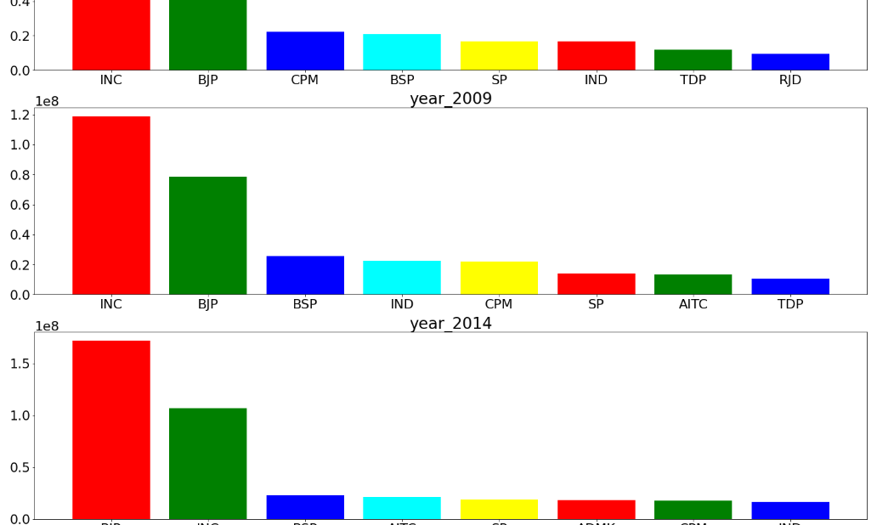
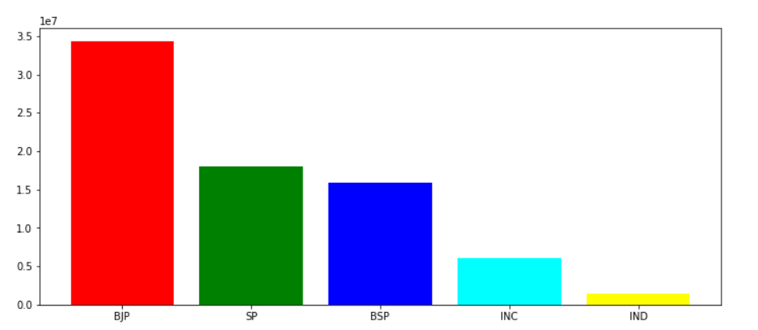
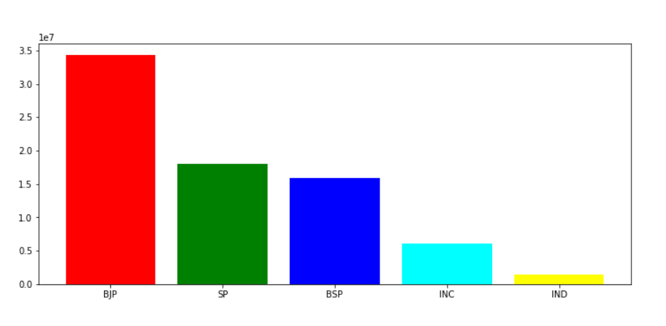
EDA
Class imbalance and its treatment:
We have performed the seaborn libraries to help to visualization the data as per the year.
We have visualized the data as per the state UP and Maharashtra to check the top parties in 2014.
UP State
Maharashtra State

Slide 10
Feature Engineering
Create relevant features that may influence election outcomes, such as voter turnout rate, candidate's political experience, party affiliation, campaign spending per capita, and social media sentiment.
Conduct exploratory data analysis to identify meaningful patterns and relationships between features and election results.

Slide 11
Model Selection
Evaluate various machine learning algorithms suitable for classification tasks, such as logistic regression, decision trees, random forests, gradient boosting, and deep learning models.
Choose the most appropriate algorithms based on performance metrics and computational efficiency.
Training and Validation:
Split the dataset into training and validation sets to train and evaluate the chosen models.
Implement cross-validation to optimize hyperparameters and mitigate overfitting

Slide 12
Model evaluation
Evaluate the models using relevant metrics such as accuracy, precision, recall, F1-score, and confusion matrix to assess their predictive performance.
Identify the best-performing model based on the evaluation results.
Real-time Data Integration:
Develop mechanisms to integrate real-time data (if available) during elections to update the model with the latest information.
Implement a pipeline to preprocess and feed new data into the model for real-time predictions.
Model Deployment and Interface:
Deploy the selected model to a production environment, making it accessible for stakeholders to use.
Create a user-friendly interface or dashboard where users can input relevant data for predictions and visualize the results.

Slide 13
Conclusion – Success criteria
The success of this project will be measured based on the following criteria:
Prediction Accuracy: The machine learning model should achieve a high level of accuracy in predicting the election winners on a hold-out test dataset.
Stakeholder Feedback: Feedback from political parties, candidates, and analysts will be considered to assess the usefulness and practicality of the predictions provided by the model.
Real-World Impact: The adoption of the model's predictions by political stakeholders and its contribution to improving campaign strategies and electoral efficiency will be evaluated.
Scalability and Maintainability: The developed solution should be scalable and easy to maintain, allowing for future updates and adaptations to changing election scenarios.

Slide 14
Thank You..!

